Slide 1
Welcome TO
Job Circular Management

Slide 2
Submission:
Submitted By:
Rakibul Hasan
Id:17182103245(38)
Md Shovon Biswas
Id:17182103227(38)
Nazmul Haque
Id:17181103062(37)
Naznin Akther
Id:16173103106 (36)
Submitted To:
Mr. Mijanur Rahman
Assistant Professor,
Department of CSE

Slide 3
Problem Statement:
It is not possible for job seekers to view newspaper daily and the result is many of the people are become unaware of jobs. People have to visit different places for the jobs which is much time consuming.

Slide 4
Purpose:
The purpose of the online job portal is to give the job seekers a platform for finding a right and satisfactory job according to their qualification. It also connects with the major organizations.

Slide 5
Introduction:
The main stakeholder of this system is:
Job seekers.
Job provider.
Admin of the site.
Admin of the Company.
This system enables the admin to log-in and post the jobs vacancies to the websites.The Admin helps the job seekers with a vacancy and interview schedule.Admin is able to do any kind of work in the system.
Companies can ads their circular post the website by paying system.
This system enables the jobseekers to log-in and search for job and see the vacancies.
If the job seekers don’t have any account they can register by giving their information.

Slide 6
Objectives:
Companies can ads their vacancy post.
To find the eligible candidates in easy way.
To make the recruiting process efficient and reliable.
To automated the recruiting process.
To reduce the workload of HR department.
To conduct the online job applicant test.

Slide 7
Software Requirements:
The software requires the support of the databases.
HTML,CSS,Bootstrap,PHP editors.
Mysql for database.
Server.

Slide 8
Languages:
Front-End:
HTML
CSS
BOOTSTRAP
Back-End:
PHP

Slide 9
Project Overview:
Administrator:
Should be able to create a new applicant.
Should be able to change any of the editable details for the applicant.
Should be able to search on Applicant Number and Vacancy Number.
Attach an applicant to a vacancy - The relationship between applicant and vacancy.

Slide 10
Project Overview:
Job Seeker:
Should be able to view all vacancies scheduled to be taken.
Should be able to view the details of the company.
Should be able to view the details of the vacancy.
Should be able to search on vacancies, Applicant Number and Vacancy Number.

Slide 11

Project Overview:

Slide 12
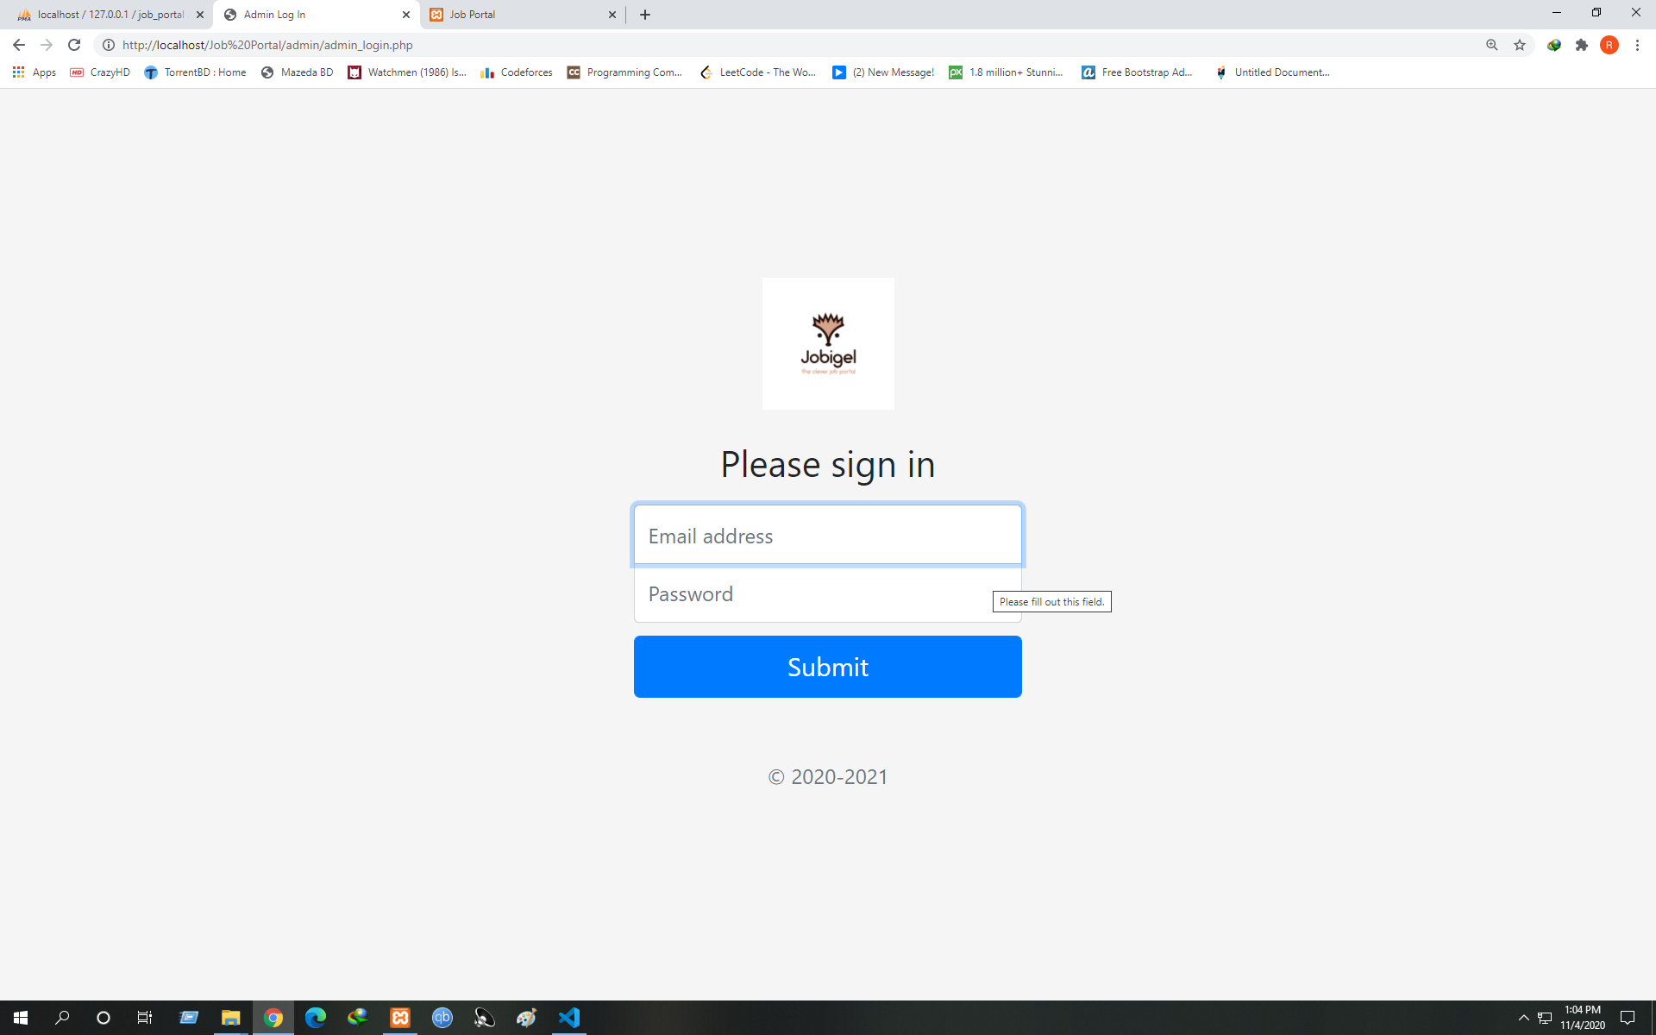
Screenshot:

Slide 13
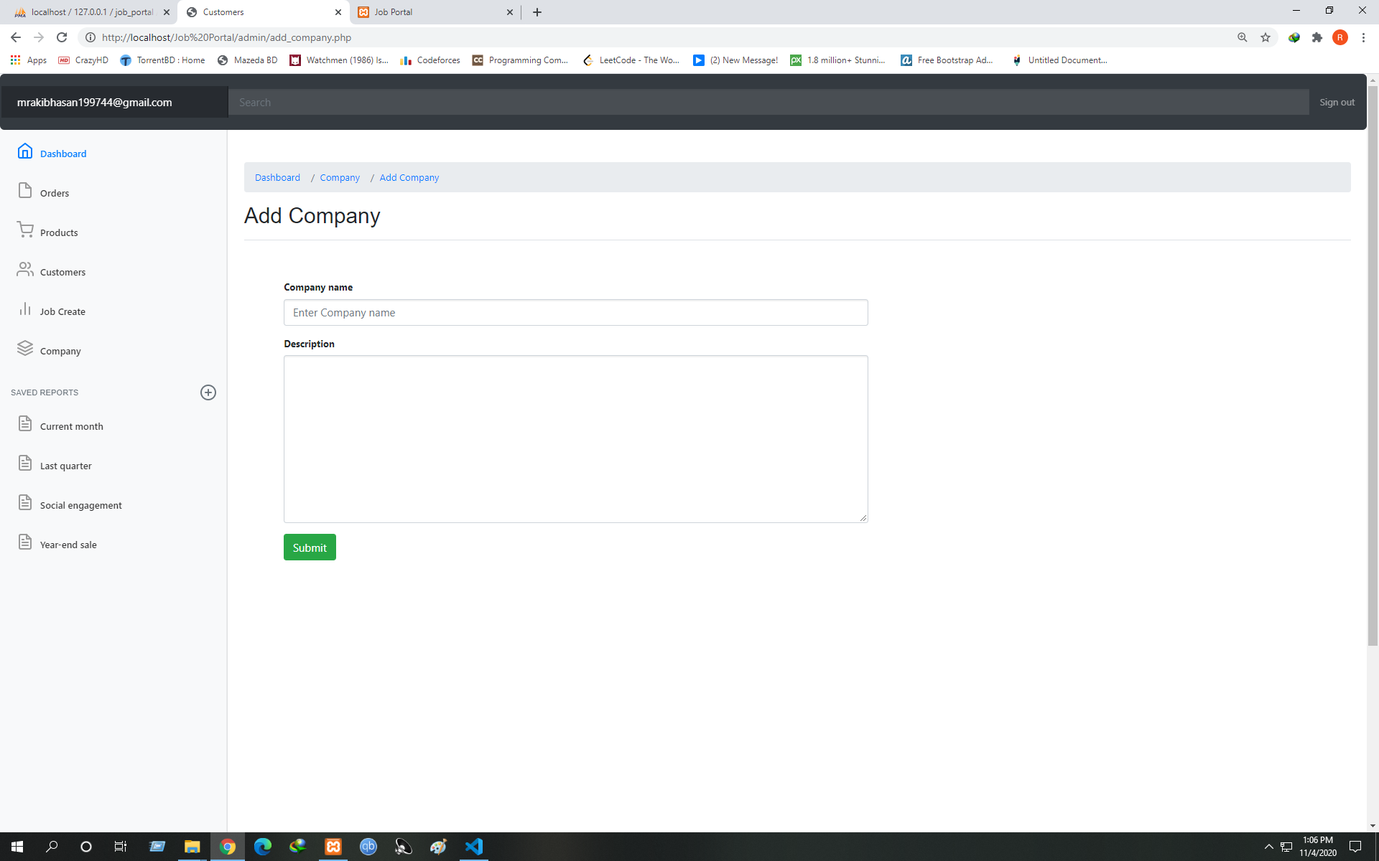

Slide 14
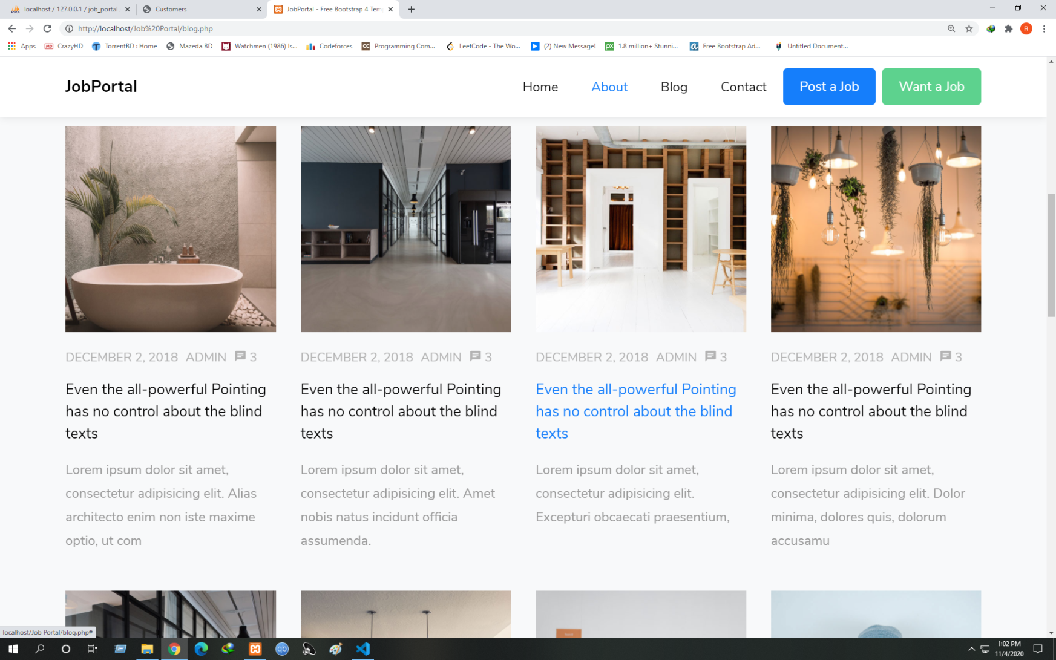
Screenshot:

Slide 15
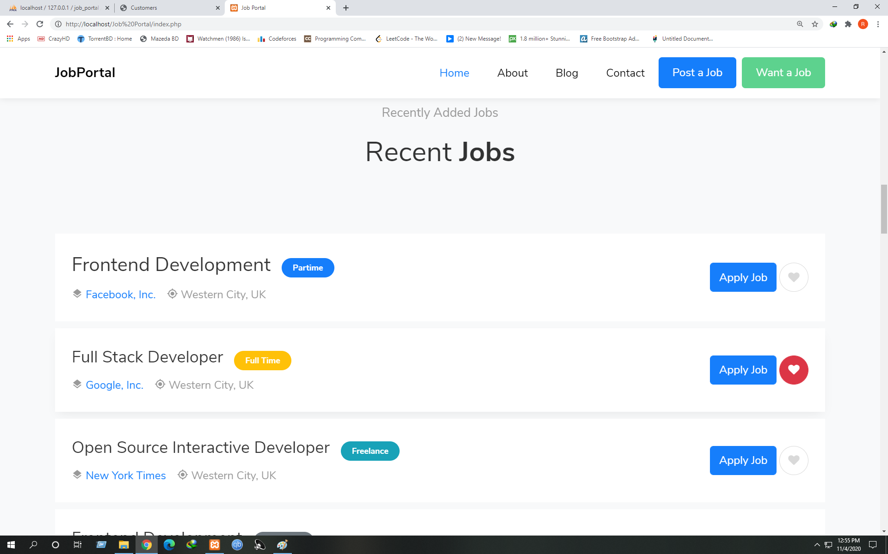
Screenshot:

Slide 16
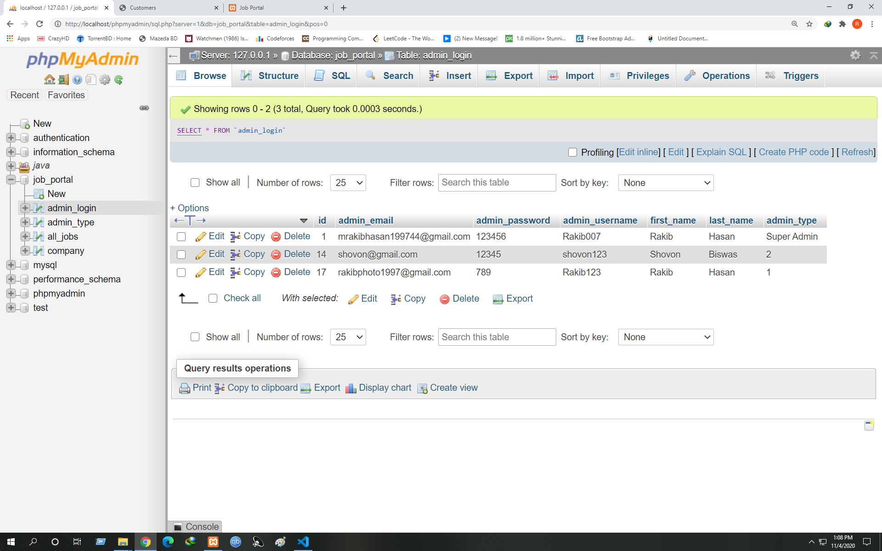
Database:

Slide 17
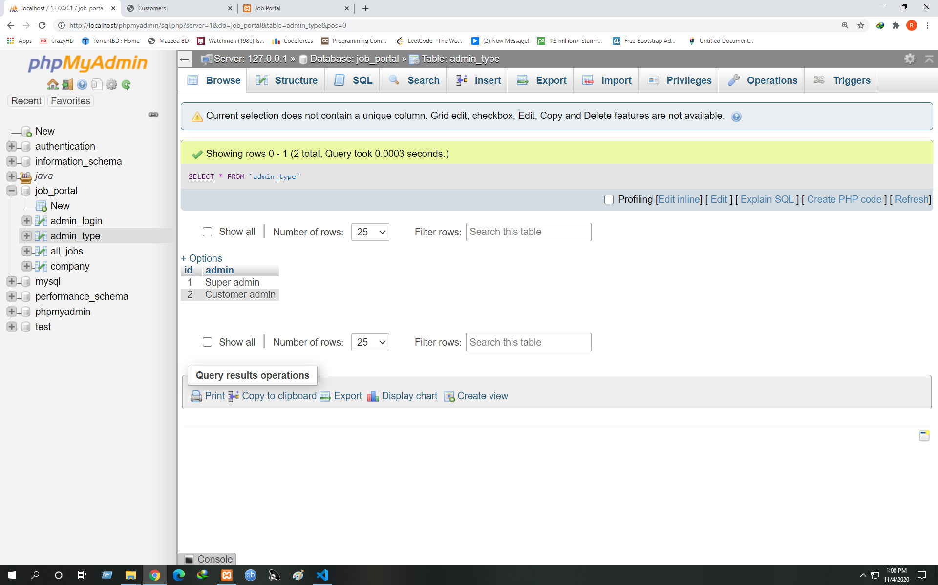
Database:

Slide 18
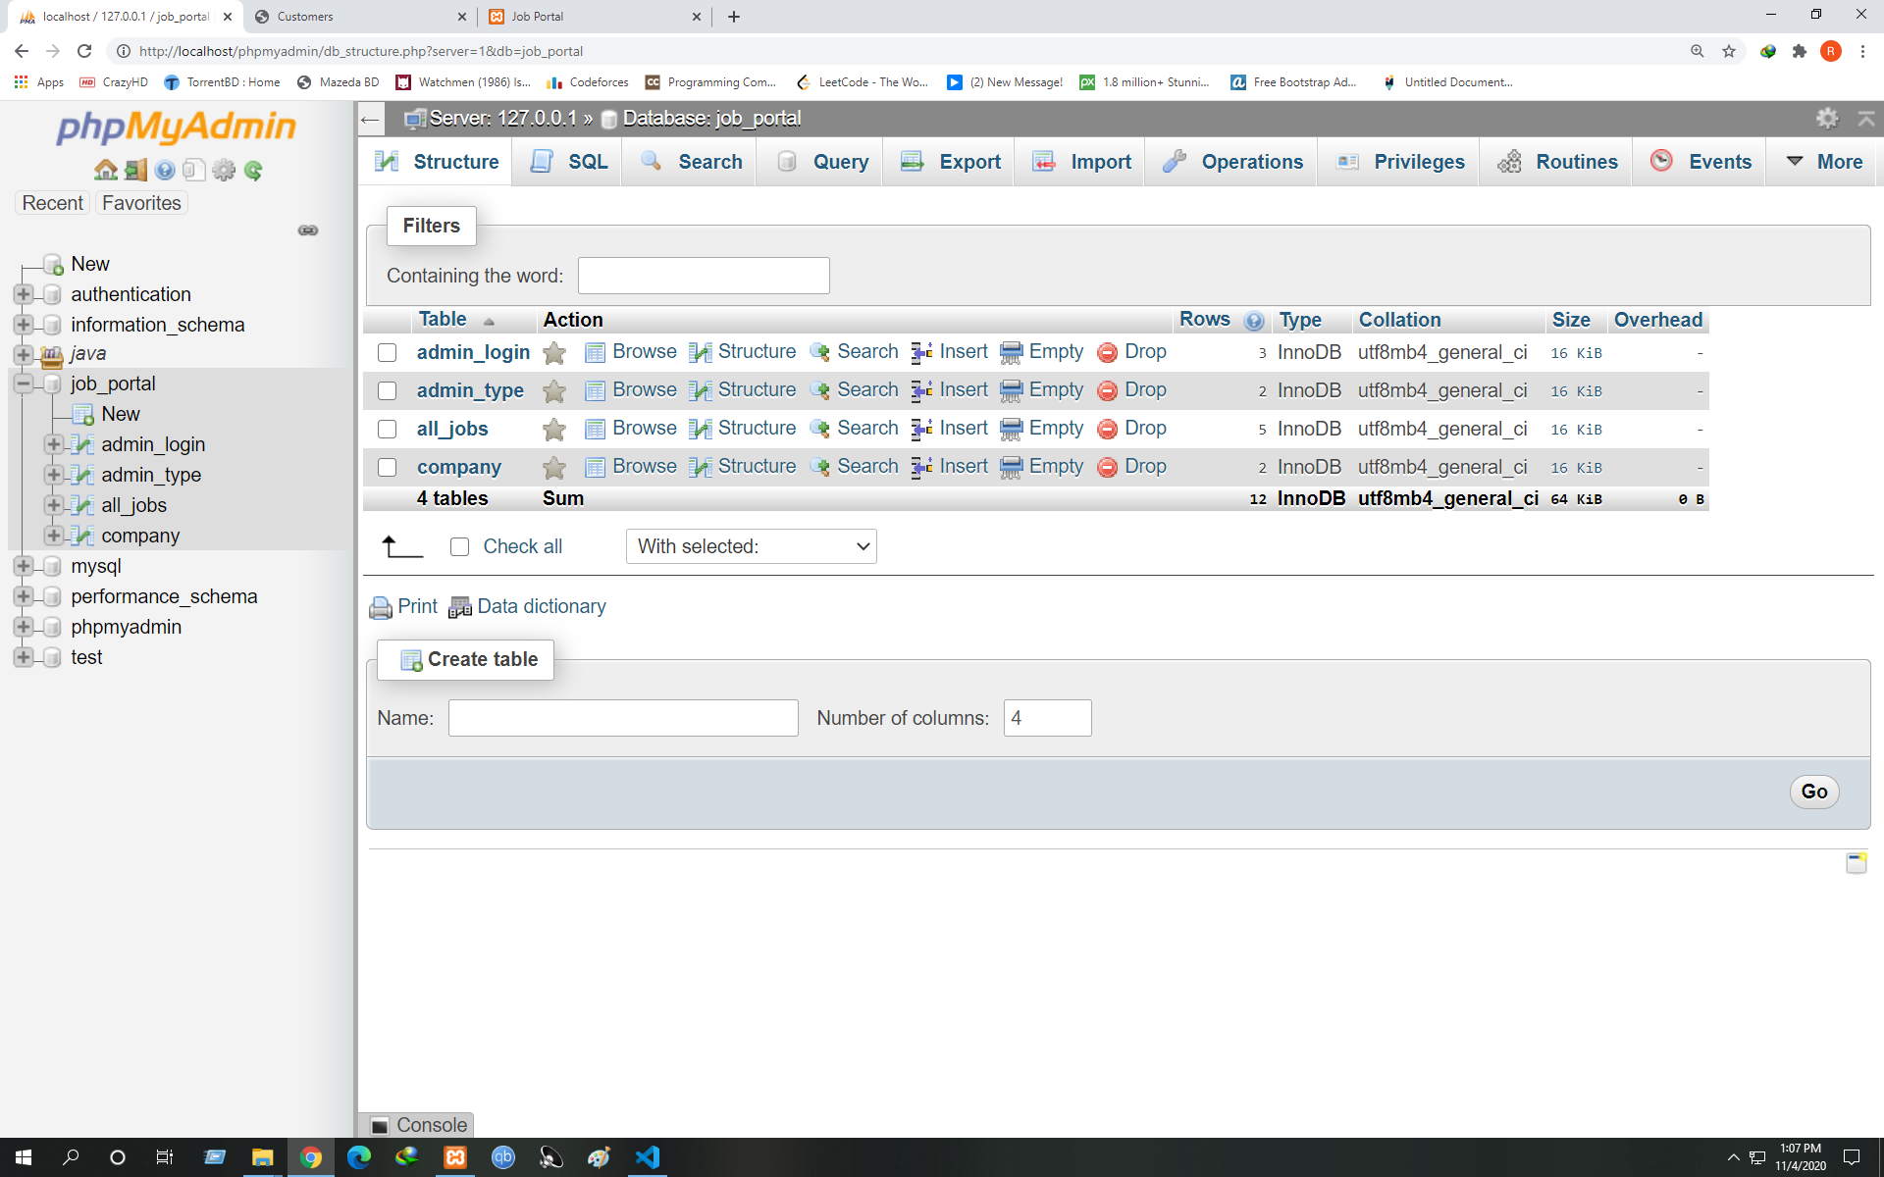
Database:

Slide 19
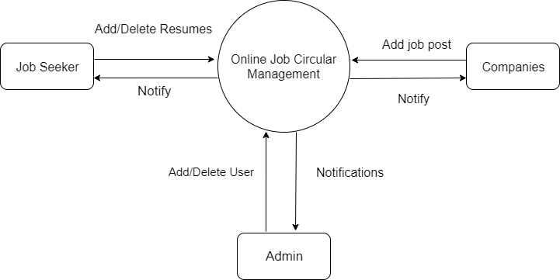
DFD:

Slide 20
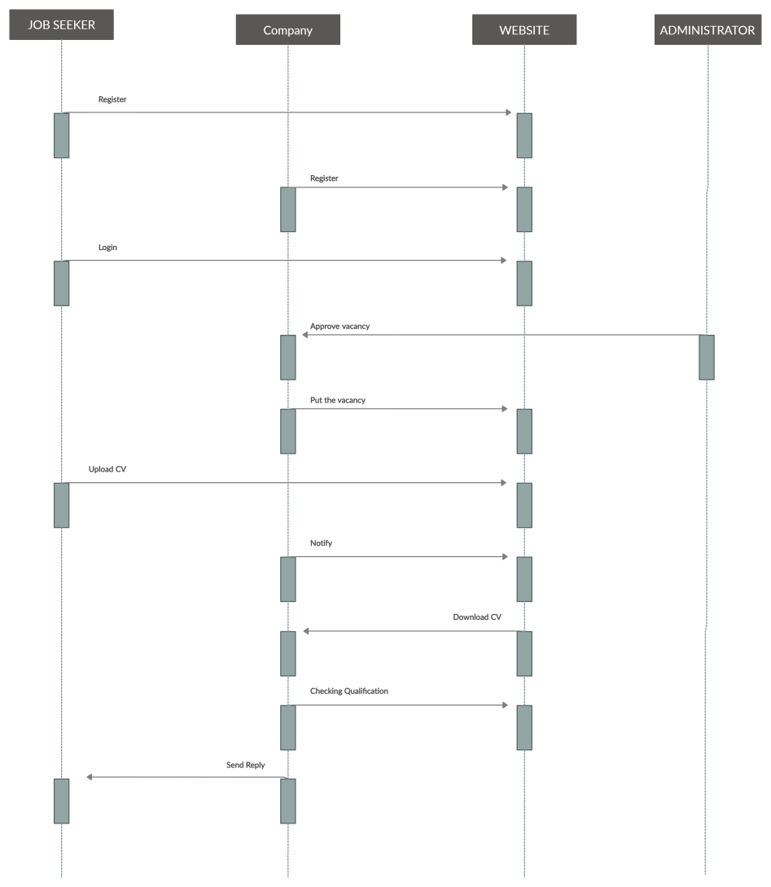
ER-Diagram:

Slide 21
Thank You! Any Question??

